Slide 1
Lecture 5 Kirchhoffs Law

Slide 2
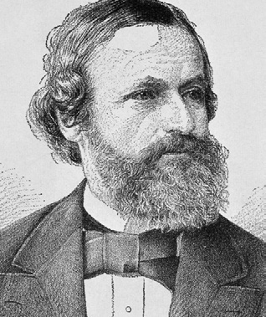
Introduction
In 1845, a German physicist, Gustav Kirchhoff developed a pair of laws that deal with the conservation of current and energy within electrical circuits.
These two laws are commonly known as Kirchhoff’s Voltage and Current Law. These laws help in calculating the electrical resistance of a complex network or impedance in case of AC and the current flow in different streams of the network

Slide 3
Kirchhoffs Law
In complex circuits such as bridge or T networks, we can not simply use Ohm’s Law alone to find the voltages or currents circulating within the circuit.
For these types of circuits we need certain rules which allow us to obtain the circuit equations and for this we can use Kirchhoffs Law.

Slide 4
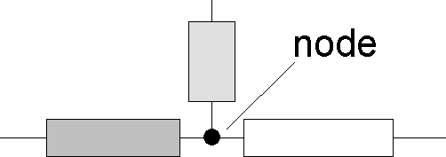
Kirchhoff’s Current Law
It states that at any instant the algebraic sum of the currents at a junction or node in a network is zero.
A point at which two or more elements have a common connection is called a node as in Fig.1
Different signs are allocated to currents held to flow towards the junction and to those away from it.
Figure.1

Slide 5
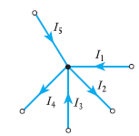

Kirchhoff’s Current Law(cont)
Figure.2 Currents at a node illustrating KCL.
In this example(Fig.2), we have assigned (generally) currents flowing towards the junction have been considered positive and those flowing away from the junction are negative
$I_{1}−I_{2}+I_{3}−I_{4}+I_{5}=0$
Some textbooks, they write this same equation in a different way.For example positive sign to a term that refers to a current that leaves a node, and a negative sign to a term that refers to a current that enters a node.
${−I}_{1}+I_{2}−I_{3}+I_{4}−I_{5}=$0

Slide 6

Kirchhoff’s Current Law(cont)
The sum of the currents entering a node is equal to the sum of the currents leaving the node
$I_{1}+I_{3}+I_{5}=I_{2}+I_{4}$
Mathematically, KCL implies that
where N is the number of branches connected to the node and $i_{n}$ is the n th current entering and leaving the node

Slide 7
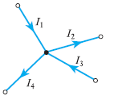
Problem -1
Problem-1
For the network junction shown in Fig. 3, calculate the current I3, given that I1 = 3 A, I2 = 4 A and I4 = 2 A.
Figure.3
I1 − I2 + I3 − I4 = 0
I3 = −I1 + I2 + I4 = −3 + 4 + 2 = 3A

Slide 8
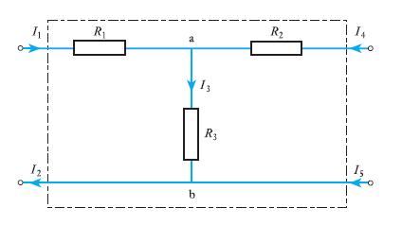
Problem -2
With reference to the network shown in Fig.4, determine the relationship between the currents I1, I2, I4 and I5
For junction a:
I1 + I4 − I3 = 0
hence I3 = I1 + I4…(1)
For junction b:
I3 + I5 − I2 = 0
I3 = I2 − I5……..(2)
Sub (1) in (2) Figure.4
I1 + I4 = I2 − I5 and I1 − I2 + I4 + I5 = 0

Slide 9
Kirchhoff’s voltage law (KVL)
It states that the algebraic sum of all voltages around a closed path (or loop) is zero.
Circuit terminology.
A branch is any portion of a circuit with two terminals connected to it.In practice, any circuit element with two terminals connected to it is a branch.
Figure 5

Slide 10
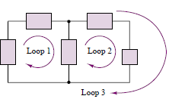
Loop
Loop
Loop is any closed path in the circuit formed by branches.
Figure.6

Slide 11
Kirchhoff’s voltage law
If the current flows from higher potential to lower potential in an element, then we consider it as a voltage drop.If the current flows from lower potential to higher potential, then we consider it as a voltage rise.
We will assign a positive sign to a term that refers to a voltage drop, and a negative sign to a term that refers to a voltage rise.
We can start with any branch and go around the loop either clockwise or counter clockwise. For this example (generally), we go around loop in clockwise direction.

Slide 12
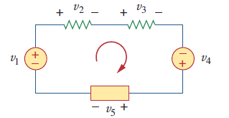

KVL Example
Applying KVL for the loop
$−v_{1}{+v}_{2}+v_{3}{−v}_{4}+v_{5}$=0
Rearranging terms gives
$v_{2}+v_{3}+v_{5 }=v_{1}+v_{4}$
Figure.7
Sum of voltage drops = Sum of voltage rises

Slide 13
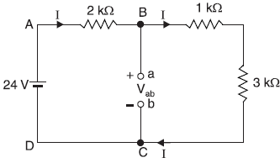

Problem-3
Use Kirchhoff’s voltage law to find the voltage Vab
Total circuit resistance, ${ R}_{T}$ = 2 + 1 + 3 = 6 kΩ
Circuit current, I =$\frac{V}{R_{T}}$ = $\frac{24}{ 6X{10}^{−3}}$ =4 mA
Applying Kirchhoff’s voltage law to loop
ABCDA, we have,
– 24 + (4 × 10⁻³ )(2×10 ³ ) + Vab = 0
Figure.7
– 24 + 8 + Vab = 0
– 16 + Vab = 0
Vab = 16 V

Slide 14
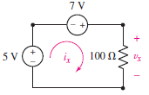

Problem-4
Find $v_{x}$ and $i_{x}$in the circuit
Figure.8
Apply KVL around the loop:
−5 − 7 + $v_{x}$ = 0
$v_{x}$ = 12 V.
voltage across the 100 Ω resistor.
$i_{x}=\frac{v_{x}}{100}=\frac{12}{100}=0.12A$

Slide 15
Reference
Edward Hughes. “Electrical and Electronic Technology”, 10th Edition, Pearson Education Asia, 2019.
Charles K. Alexander and Matthew N. O. Sadiku. “ Fundamentals of Electric Circuits”, 5 th Edition, Tata McGraw Hill, 2012

Slide 16
Thank You

